Slide 1
Traffic control using video and network data – we see everything
DETECTION OF TRAFFIC CONGESTION AT A PARTICULAR JUNCTION USING IMAGE DATA, AND PREDICTING OPTIMAL TRAVEL TIME PREDICTION IN A GIVEN RANGE.
WE COMBINE BOTH VIDEO FEATURES AND NETWORK FEATURES ( GOOGLE API DATA) TO DETECT THE TRAVEL TIME
Sainath reddy

Slide 2
MODEL
TRAFFIC CAMERA
Open vino optimized model. Deployed in neural compute stick 2 (edge visual processing unit).
OBJECT DETECTOR+
TRACKER
GOOGLE API DATA
CONGESTION ESTIMATION
DEEP FEATURES
CONCAT FEATURES
Other features
VEHICULAR BEHAVIOURAL TRACKING
OPTIMAL TIME+ETA

Slide 3
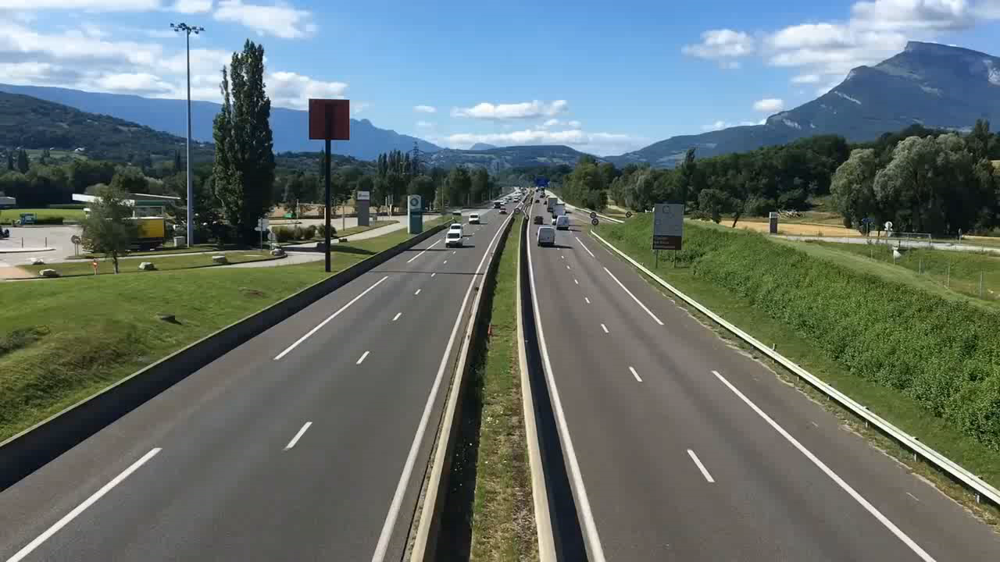
Video indicating less congestion
SOLUTION( MODEL)
INDICATOR | VALUE
TOP RIGHT BLUE | SPEED
TOP RIGHT RED | AREA OCCUPIED BY VEHICLES
COUNT ON BBOX (red) | UNIQUE VEHICLE ID
NUMBER RIGHT TO BBOX IN GREEN | SPEED OF INDIVIDUAL VEHICLE
NAME RIGHT TO BBOX IN VEHICLE | OBJECT TYPE

Slide 4

https://youtu.be/moZ4RmncEeA
Video indicating high congestion (embed video from my youtube)
Top Right blue number – average speed (very low considering high congestion)
Top left red number – total area occupied (very high because of high congestion )

Slide 5
Video indicating low congestion
Top Right blue number – average speed (very high because less congestion)
Top left red number – total area occupied (very low because less congestion)

Slide 6
WE ALSO TRACK
FAST MOVING VEHICLES(VEHICLES WHICH EXCEEDS SPEED LIMIT)
VEHICLES MOVING THE WRONG SIDE OR GOING IN WRONG LANE
VEHICLES WHICH CROSS TRAFFIC SIGNAL
HEAVY VEHICLES ENTERING RESTRICTED ROADS AT PEAK TIME

Slide 7
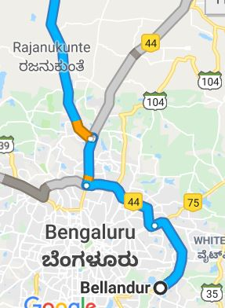
Y ITS WORTH ?
How google do
The green, yellow and red routes that Google Maps uses to indicate clear, slow-moving, or heavily congested traffic are a great help when you're trying to determine the fastest way to your destination, but how does Google know the traffic conditions between where you are and where you're trying to go?
Google Maps bases its traffic views and faster-route recommendations on two different kinds of information: historical data about the average time it takes to travel a particular section of road at specific times on specific days and real-time data sent by sensors and smartphones that report how fast cars are moving right
y it fails
Even though the vehicles are parked on the side of the lane , that section of the road receives high gps ping and false congestion is predicted
It doesn’t warn users on speeding or breaking traffic rules
Surveillance behavior and women safety
In addition we also provide optimal start time and nearest safe places
8
9:00 am
9
a
9:35 am
10:00am
40

Slide 8
Market plan
months
Collect data
Build insights
months
Transport authorities
Rapido
year
Big firms
uber
Test the mode

Slide 9
Financial projections
Financial compliances gov. permissions
Cameras and support hardware
Gpu and compute system (ex. NCS2 for inference)
Storage system

